Slide 1
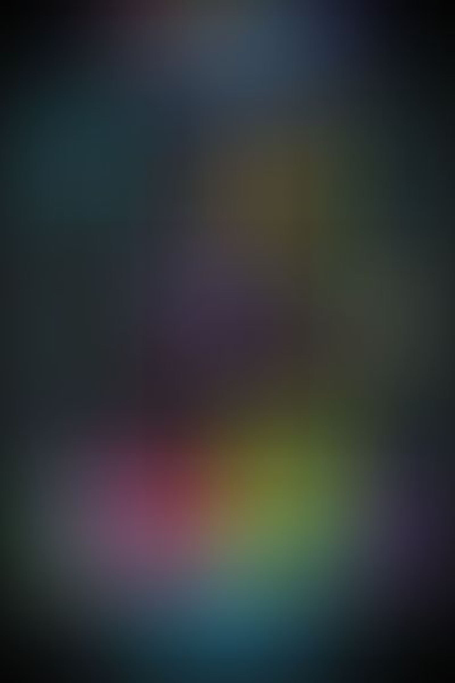
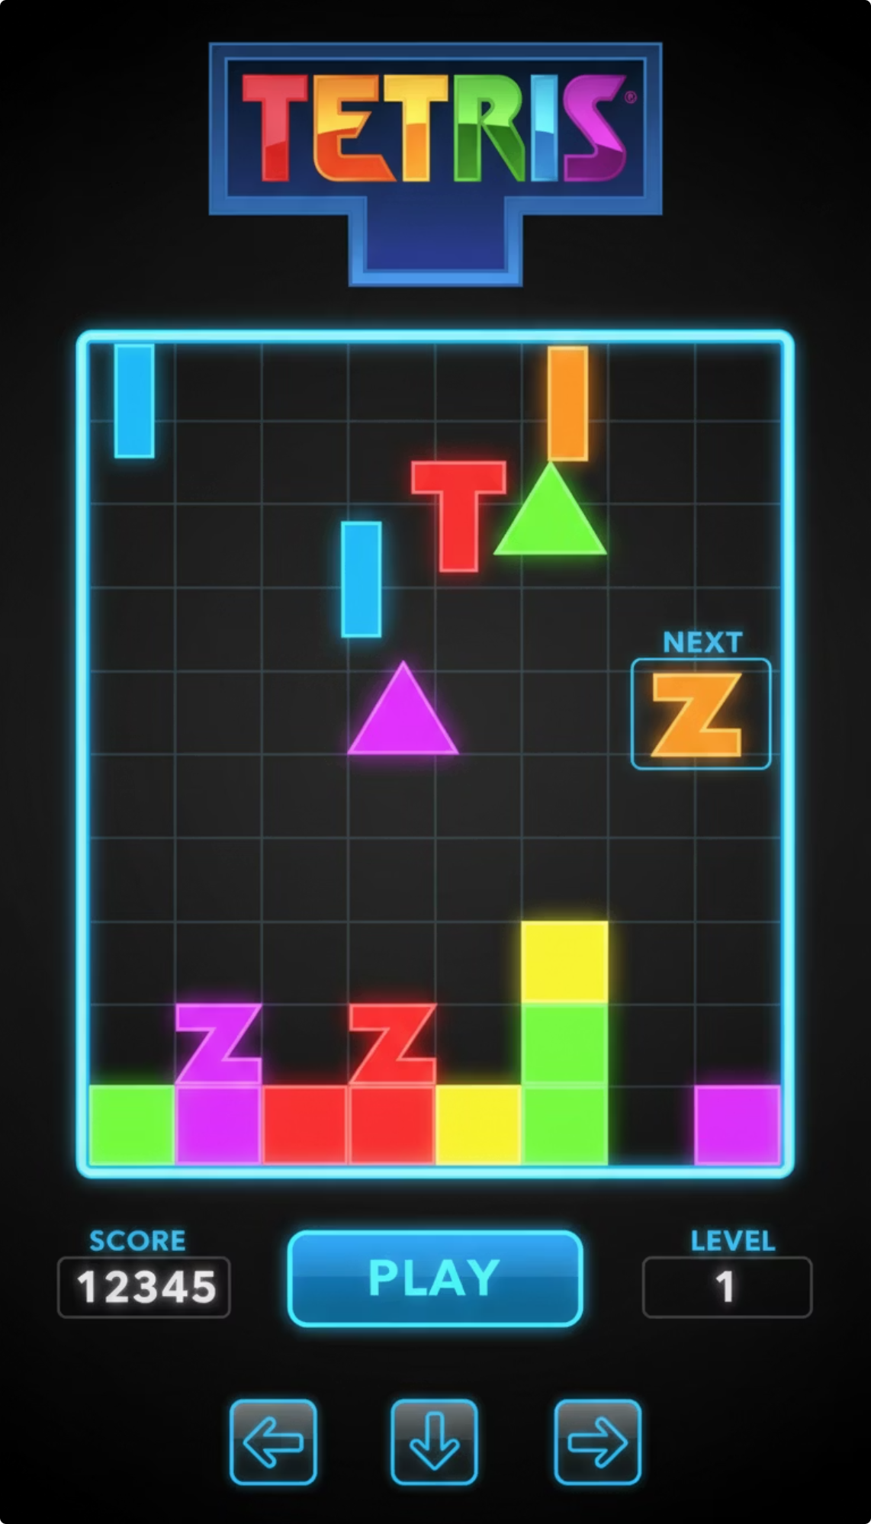
Tetris Game: Semester Project
Developed using C++ & SFML 3.0.2
Submitted by: 1. Muhammad Abdullah (2502946) 2. Muhammad Zohaib (2502870)
Section : BSSE-1-B F-25
Instructor : Ms Seemab Khan

Slide 2
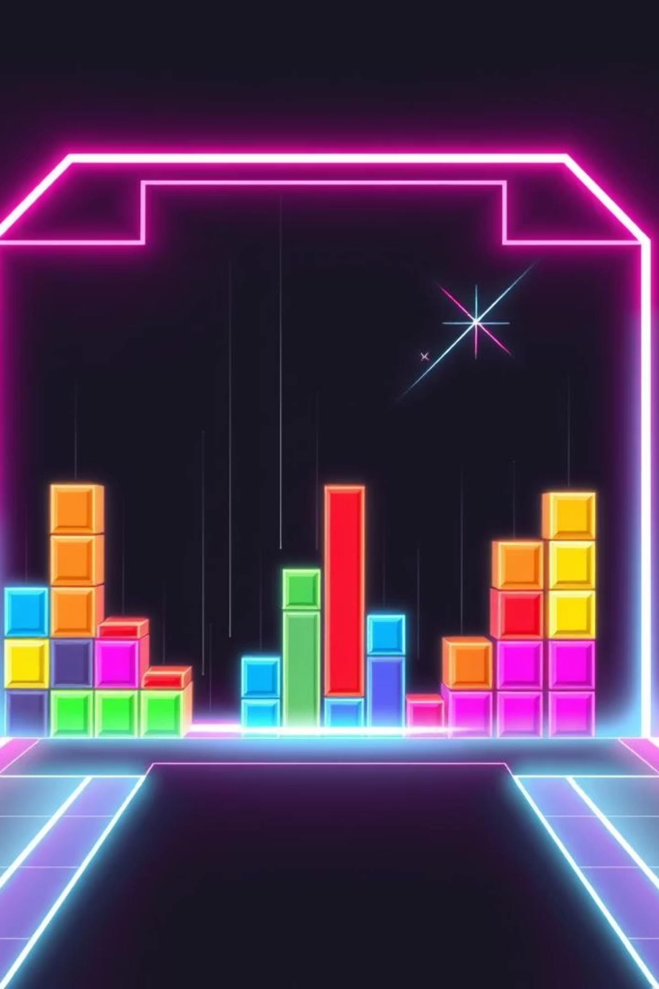
Introduction to Tetris
Tetris is a classic tile-matching puzzle game, originally developed in 1984. The objective is to arrange falling blocks, known as Tetrominoes, to form complete horizontal lines.
These completed lines are then cleared, contributing to the player's score. This project revives the timeless appeal of Tetris with modern implementation.

Slide 3
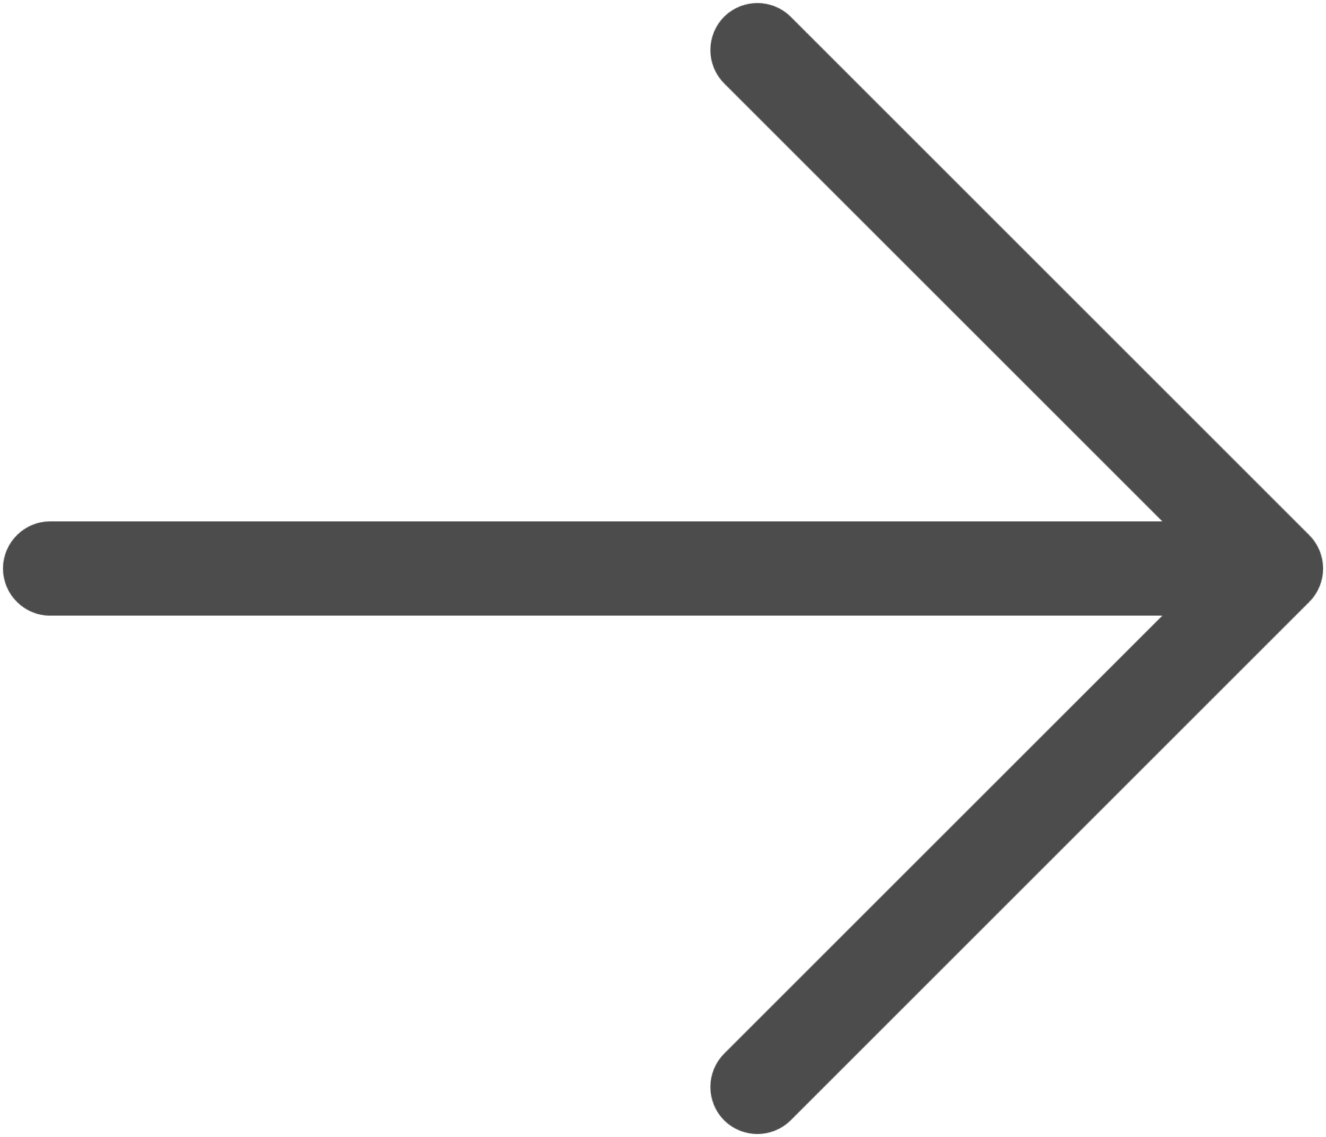

Gameplay Mechanics: How to Play
Automatic Descent
Tetrominoes fall automatically from the top of the screen.
Player Control
Players use keyboard keys to move and rotate blocks, strategically fitting them into available spaces.
Increasing Challenge
The falling speed increases over levels, making the game progressively more difficult.
Game Over Condition
The game concludes when the accumulated blocks reach the top of the playing area.

Slide 4
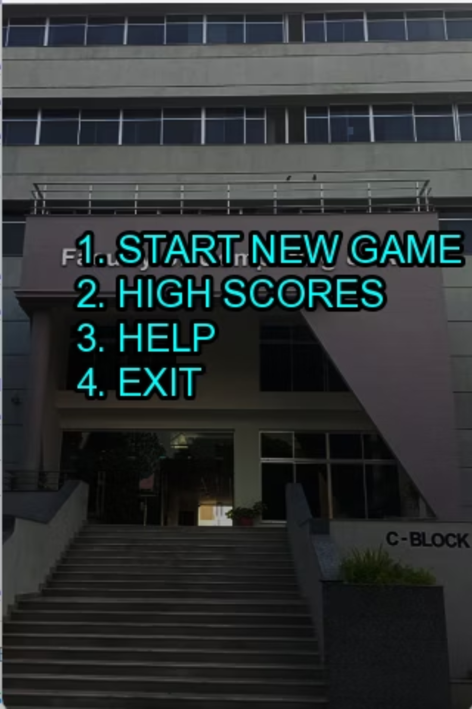
Main Menu: Your Starting Point
Upon launching the game, players are greeted by an intuitive, menu-driven interface. All interactions are managed through keyboard input, offering a seamless user experience.
Start New Game
High Scores
Help
Exit

Slide 5
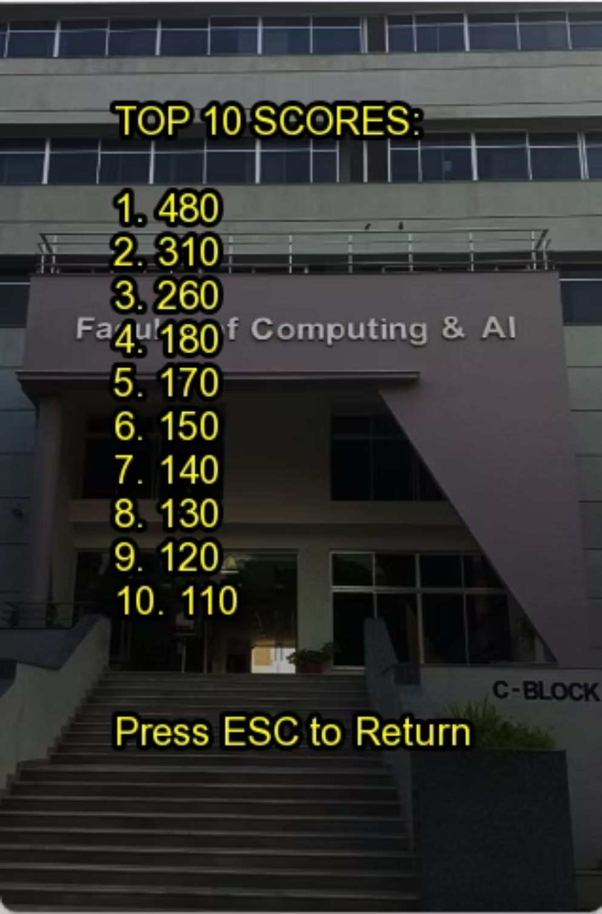

High Scores: Challenge and Replayability
The High Scores screen proudly displays the top 10 highest scores achieved. This feature, implemented using robust file handling in C++, reads and stores data from 'highscores.txt'.
This encourages friendly competition and significantly boosts the game's replayability.

Slide 6
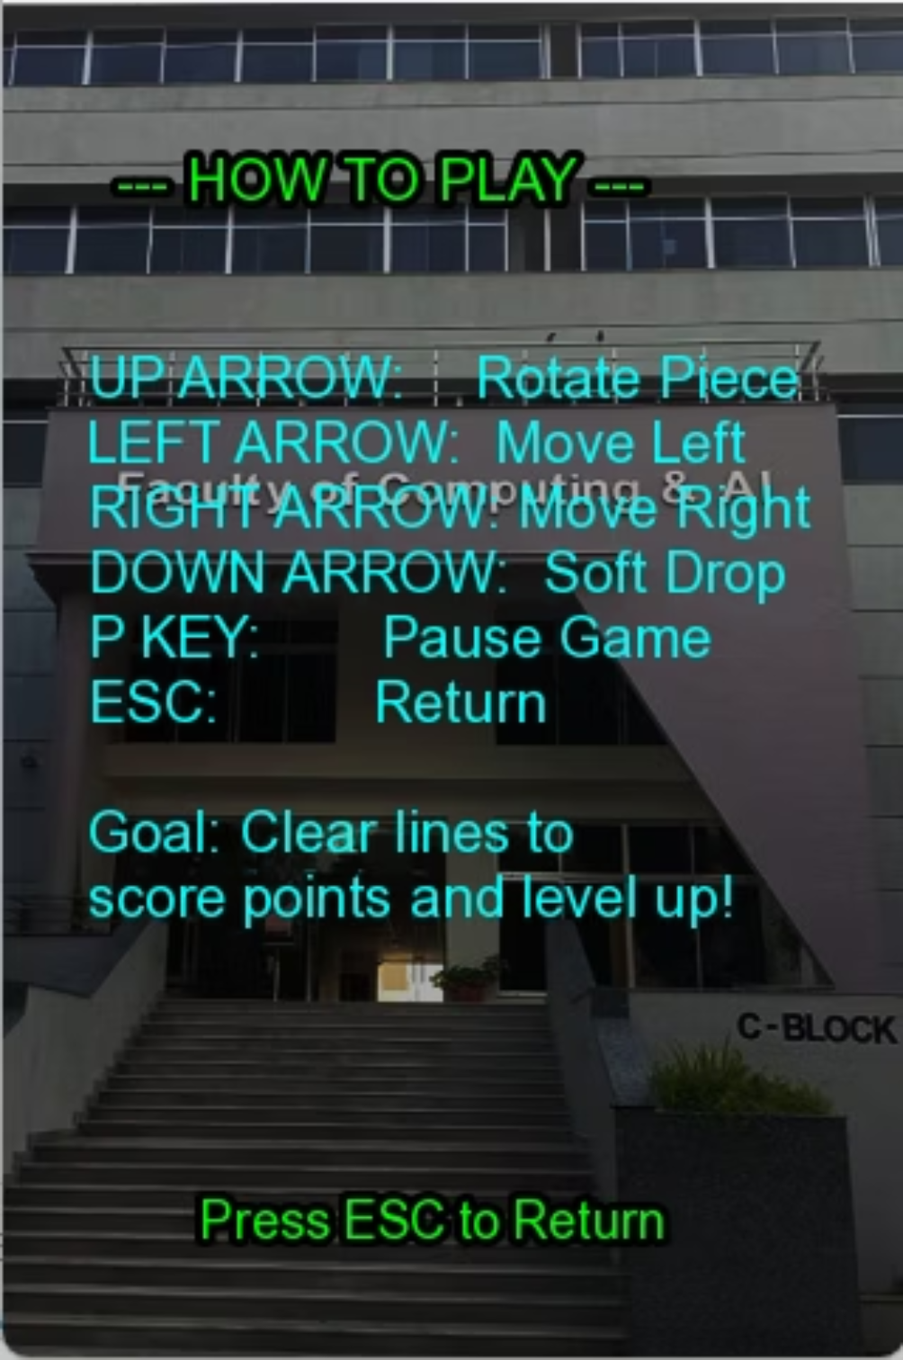
Help Screen: Guiding New Players
The Help Screen is designed to enhance user understanding and usability. It provides essential information for both new and experienced players:
Detailed game rules
A comprehensive guide to controls and key bindings
Instructions for optimal gameplay
This ensures a smooth onboarding experience and helps players master the game quickly.

Slide 7

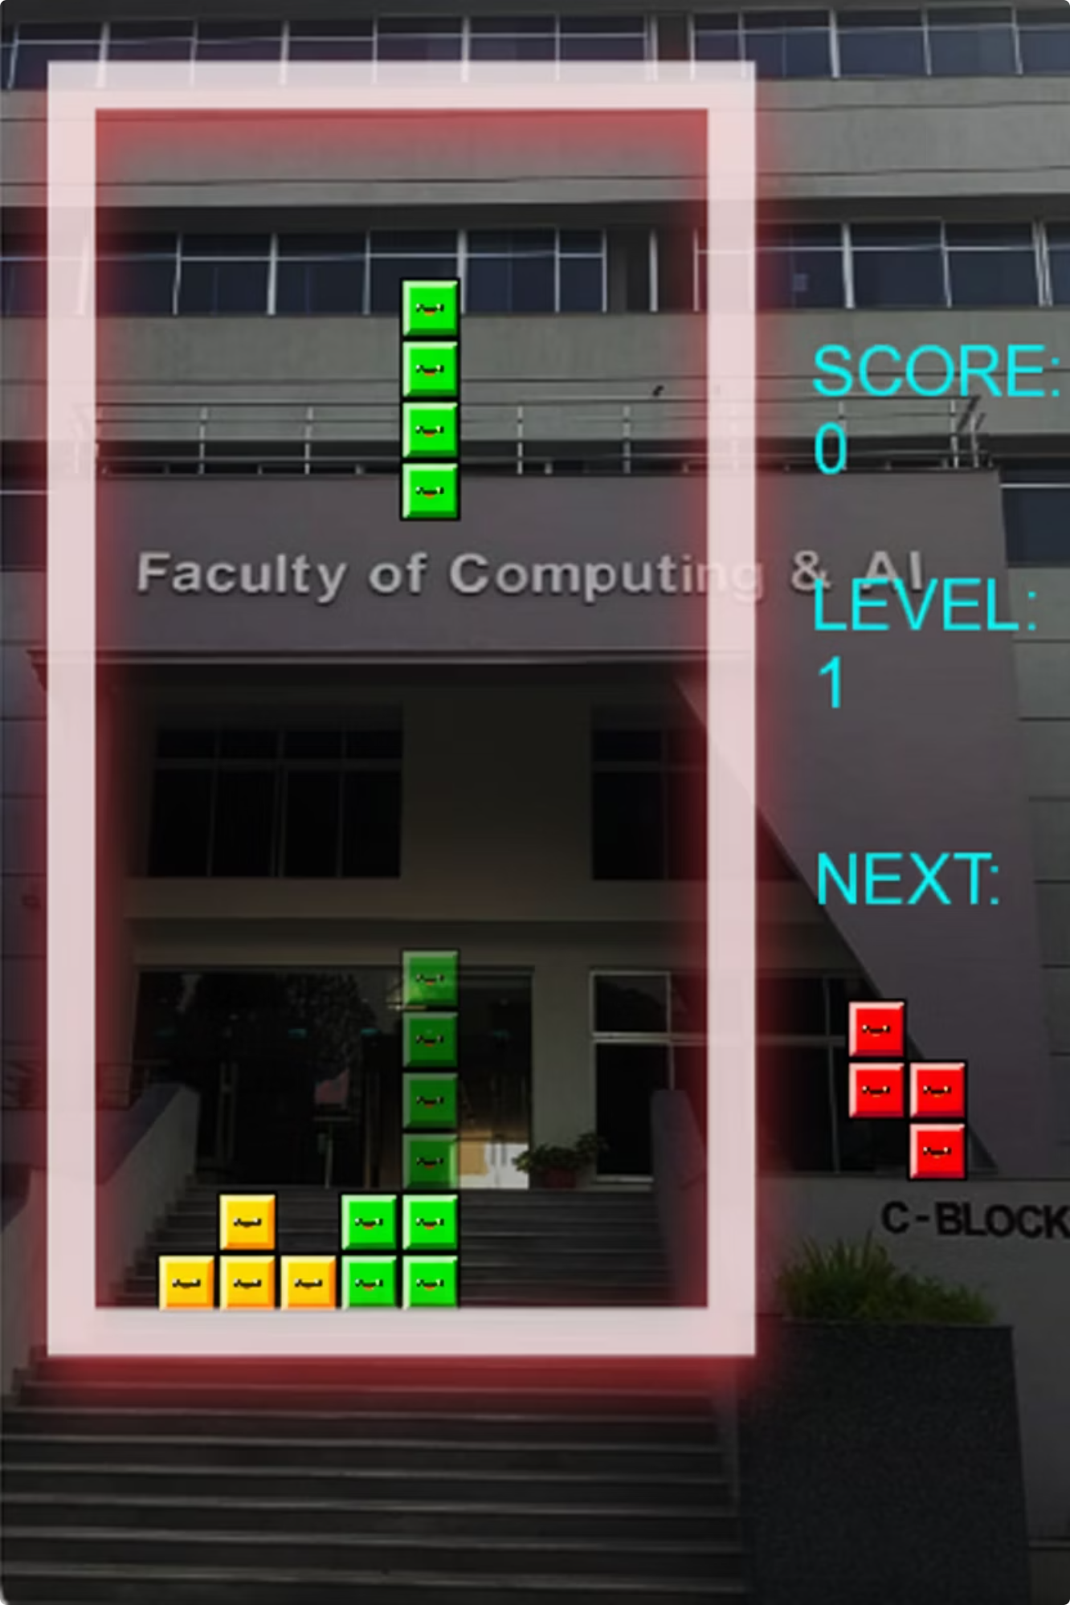
Core Gameplay: The Action Screen
The Gameplay Screen presents all critical information at a glance, allowing players to focus on strategy:
The main playing matrix
The currently falling Tetromino
A shadow indicating the block's landing position
Real-time score and level indicators
A preview of the next block for strategic planning

Slide 8
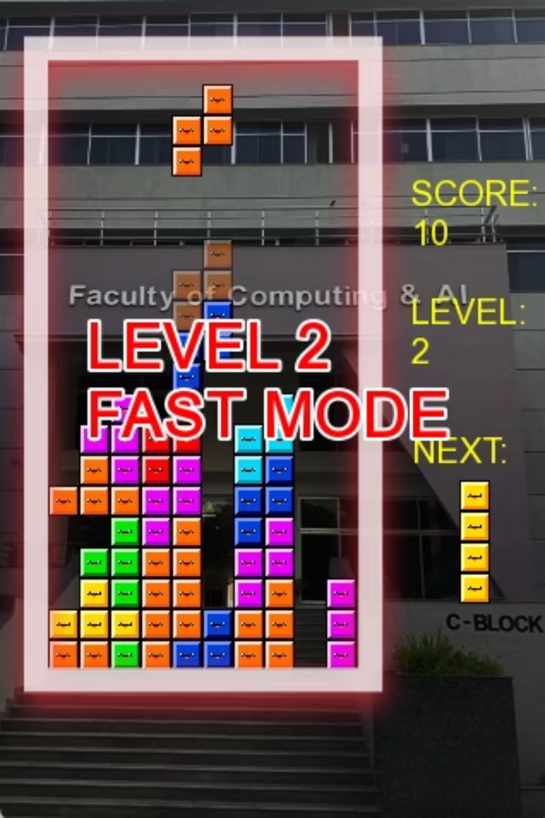
Levels and Difficulty Progression
Beginner Level
Designed for new players, this level features a limited range of block types and a slower falling speed, allowing players to learn the ropes without overwhelming pressure.
Advanced Level
For seasoned players, this level unlocks all Tetromino types and significantly increases the falling speed, demanding quicker reflexes and advanced tactical thinking.
The difficulty dynamically adjusts as the game progresses, ensuring a continuous challenge for players of all skill levels.

Slide 9
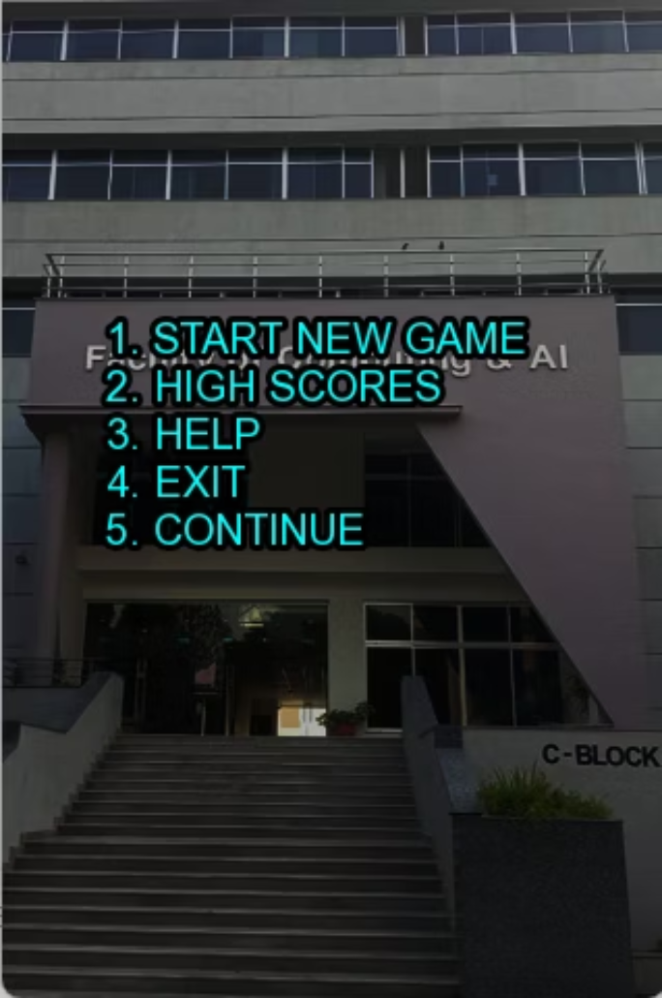
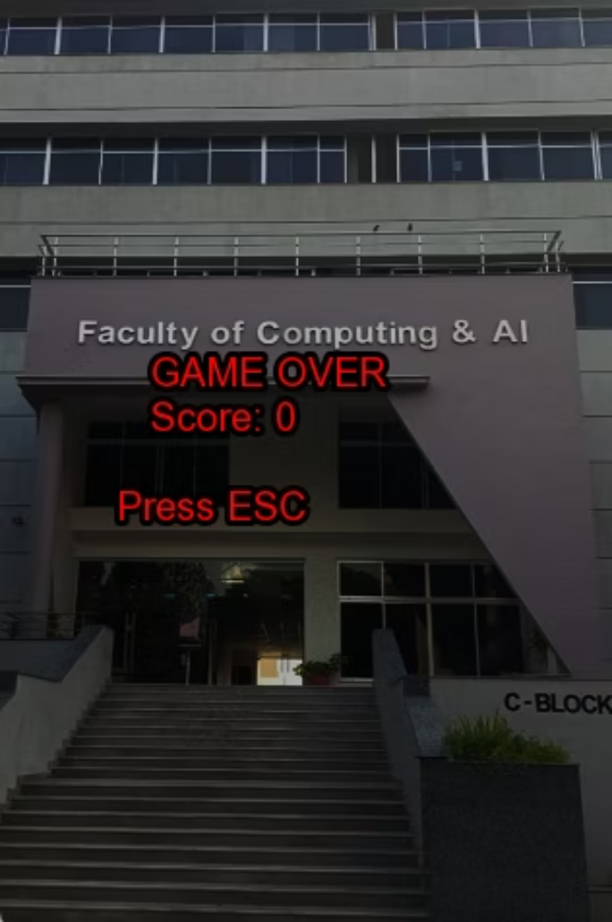
Game States: Pause and Game Over
Pause Screen
Game Over Screen
Accessed by pressing the 'P' key, the pause screen allows players to momentarily freeze the game state. Options include resuming play, accessing high scores, or exiting.
When blocks reach the top, the Game Over screen displays the player's final score. Players can then press 'ESC' to return to the main menu and try again.
Start New Game
High Scores
Help
Exit
Continue

Slide 10
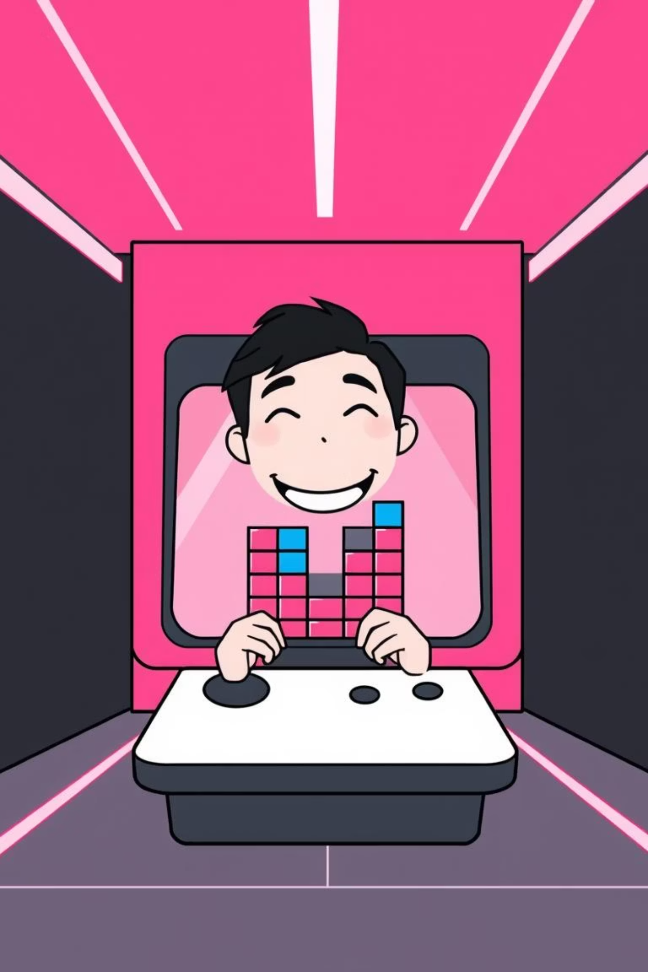
Conclusion: A Complete Tetris Experience
Project Fulfilled
1
The Tetris game successfully meets all core project requirements, delivering a robust and engaging experience.
Comprehensive Features
2
Includes menu-driven navigation, dynamic levels, a sophisticated scoring system, and seamless pause functionality.
Data Persistence
3
High scores are managed through reliable file handling, adding a competitive edge and encouraging replay.
Enhanced Usability
4
Features like the shadow block and clear controls significantly improve gameplay accuracy and player satisfaction.
This project stands as a testament to the practical application of programming fundamentals, game loop management, and effective state handling in C++ with SFML.

